Slide 1
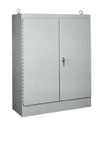
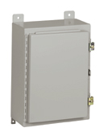
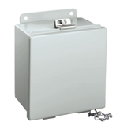
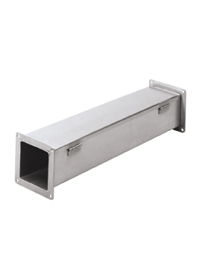
Hubbell Wiegmann
Industrial Product Offering

Slide 2


Introduction
Travis Miller
Brand Manger
1 year with Hubbell Wiegmann
Greg Jones
Engineer
1 year with Hubbell Wiegmann

Slide 3
Industrial Products
What are industrial products?
Usually Type 12, 13, 4, or 4X rated; or any combination of these ratings
More robust and time consuming to produce.
  Seam welded and ground smooth as opposed to spot welded
  Will have gasket to maintain seal
  ANSI 61 painted carbon steel, aluminum, 304 & 316 stainless steel
Industrial products are not offered with knockouts
Example applications are:
Control panels
Cabinet and cutout boxes
Terminal boxes
Instrument housing
Etc.

Slide 4





Industrial Products
What does Type 12, 13, 4, or 4X mean?
They are NEMA environmental type ratings that state in what environmental location these enclosures can be installed.
Type 12
Protects against the ingress of objects, fingers, falling dirt, settling dust and drips. It is for indoor use, so instead of protecting against windblown dust it protects against settling airborne dust, lint, fibers, and filings
Type 13
Enclosures intended for indoor use primarily to provide a degree of protection against dust, spraying of water, oil, and non-corrosive coolant.
Type 4
Gasketed door enclosure intended for indoor or outdoor use primarily to provide a degree of protection against windblown dust and rain, splashing water, and hose directed water; undamaged by ice which forms on the enclosure.
Type 4X
Gasketed door enclosure intended for indoor or outdoor use primarily to provide a degree of protection against corrosion, windblown dust and rain, splashing water, and hose directed water; undamaged by ice which forms on the enclosure.
We certify to both UL and CSA standards through UL which is technically classified as a cULus certification. We also certify to IEC 60529 for IP66 on certain products.

Slide 5
SECTION C – NEMA 12 Enclosures
B Series (Lift off cover wall mounts)
The “B” series is a Wiegmann enclosure that is rated Nema Type 12 and 13 where the lid is secured to the tub utilizing screw clamps and does not have a hinged side.
Application
Designed for use as junction boxes, terminal wiring boxes and instrument housings.
Specifications
Offered in sizes from 4”x4”x3” up to 16”x14”x6”.
Manufactured from carbon steel that is coated with ANSI 61 powder coat paint.
Gasket applied to the lid.
External mounting plates are provided.
Weld nuts are provided on sizes 6”x4”3” and larger for mounting optional sub panels.
A chain holds the cover to the tub when the lid is removed.
Back Panel
“P” series back panel

Slide 6
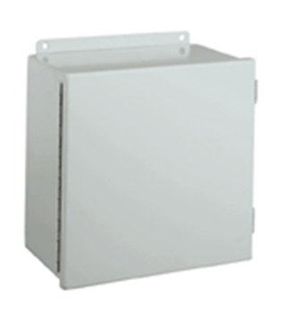
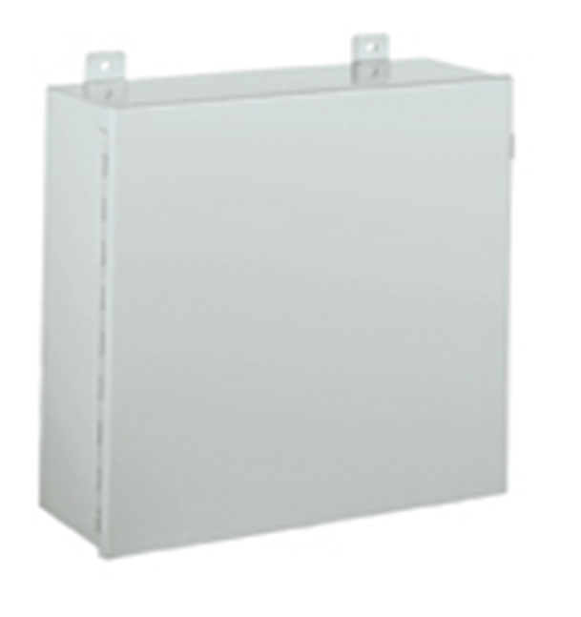
SECTION C (cont’d)
B-CH & B-CH Large Series (Hinge cover wall mounts)
The “B-CH” series is a Wiegmann enclosure that is rated Nema Type 12 and 13 where the door is secured to the tub utilizing a continuous hinge and screw clamps. It is separated into 2 categories: “B-CH” and “B-CH Large”
Applications
Designed to house electrical controls, terminals, instruments and components.
Specifications
Manufactured from carbon steel that is coated with ANSI 61 powder coat paint.
Gasket applied to the door.
B-CH
  Offered in sizes from 4”x4”x3” up to 16”x14”x10”.
  External mounting plates are provided.
  Weld nuts are provided on sizes 6”x4”3” and larger for mounting optional sub panels.
B-CH Large
  Offered in sizes from 20”x16”x7” up to 48”x36”x11”.
  External mounting feet are provided.
  Collar studs are provided for mounting optional sub panels.
Back Panel
“P” series back panel for B-CH
“NP” series back panel for B-CH Large

Slide 7
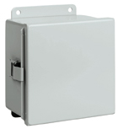
SECTION C (cont’d)
B-CHQR Series
The “B-CHQR” series is a Wiegmann enclosure that is rated Nema Type 12 and 13 where the door is secured to the tub utilizing a continuous hinge and quick release latches.
Applications
Designed for use as electrical junction boxes, terminal wiring boxes and instrument housings.
Specifications
Offered in sizes from 6”x4”x3” up to 16”x14”x6”.
Manufactured from carbon steel that is coated with ANSI 61 powder coat paint.
Gasket applied to the door.
External mounting plates are provided.
Weld nuts are provided for mounting optional sub panels.
Back Panel
“P” series back panel

Slide 8
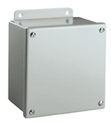
SECTION C (cont’d)
B-SC Series
The “B-SC” series is a Wiegmann enclosure that is rated Nema Type 12 and 13 where the lid is secured to the tub utilizing screws and there is no hinge side.
Applications
Designed for use as instrument housings, electrical control enclosures, terminal wiring boxes and junction boxes.
Specifications
Offered in sizes from 4”x4”x3” up to 16”x14”x6”.
Manufactured from carbon steel that is coated with ANSI 61 powder coat paint.
Gasket applied to the lid.
External mounting plates are provided.
Weld nuts are provided for mounting optional sub panels on sizes 6”x4”x3” and larger.
Back Panel
“P” series back panel

Slide 9
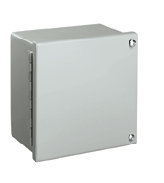
SECTION C (cont’d)
WA-GIE Series
The “WA-GIE” series is a Wiegmann enclosure that is rated Nema Type 12 and 13 where the door is secured to the tub utilizing a continuous hinge and screws
Applications
Designed for use as instrument housings, electrical control enclosures, terminal wiring boxes and junction boxes.
Specifications
Offered in sizes from 6”x6”x4” up to 14”x12”x6”.
Manufactured from carbon steel that is coated with ANSI 61 powder coat paint.
Gasket applied to the door.
No mounting plates, feet or mounting holes provided.
Weld nuts are provided for mounting optional sub panels.
Back Panel
“N1P” series back panel

Slide 10
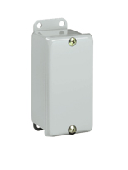
SECTION C (cont’d)
JIC Handy Series
The “JIC” series is a Wiegmann enclosure that is rated Nema Type 12 and 13 where the lid is secured to the tub utilizing screws and there is no hinge side.
Applications
Designed for use as very small instrument housings, electrical control enclosures, terminal wiring boxes and junction boxes.
Specifications
Offered in sizes from 4”x2”x2” up to 4”x4”x3”.
Manufactured from carbon steel that is coated with ANSI 61 powder coat paint.
Gasket applied to the lid.
External mounting plates are provided.
Back Panel
N/A

Slide 11
SECTION C (cont’d)
B-CHFTC Series
The “B-CHFTC” series is a Wiegmann enclosure that is rated Nema Type 12 and 13 where the door is secured to the tub utilizing a continuous hinge and quick release latches. The door opening on the tub has a flange trough collar (FTC) around all 4 sides of the opening.
Applications
Designed for use as electrical junction boxes, terminal wiring boxes and instrument housings.
Specifications
Offered in sizes from 6”x4”x4.53” up to 16”x14”x6.53”.
Manufactured from carbon steel that is coated with ANSI 61 powder coat paint.
Gasket applied to the door.
External mounting plates are provided.
Weld nuts are provided for mounting optional sub panels.
Back Panel
“P” style back panel

Slide 12
SECTION C (cont’d)
N12 Series
The “N12” wall mount series is a Wiegmann enclosure that is rated Nema Type 12 and 13 where the door is secured to the tub utilizing a continuous hinge and screw clamps.
Applications
Designed for use as housings for electrical controls, instruments, components and associated wiring.
Specifications
Offered in sizes from 12”x24”x6” up to 72”x36”x12”.
Manufactured from carbon steel that is coated with ANSI 61 powder coat paint.
Gasket applied to the door.
External mounting feet are provided.
Collar studs are provided for mounting optional sub panels.
A hasp and staple are provided for padlocking.
Back Panel
“NP” style back panel

Slide 13

SECTION C (cont’d)
WA-WF Series
The “WA-WF” series is a Wiegmann enclosure that is rated Nema Type 12 where the overlapping doors are secured to the tub utilizing continuous hinges and a 3 point latching mechanism.
Applications
Designed for use as housings for electrical controls, instruments, components and associated wiring.
Specifications
Offered in sizes from 24”x42”x8” up to 48”x48”x12”.
Manufactured from carbon steel that is coated with ANSI 61 powder coat paint.
Gasket applied to the doors.
External mounting feet are provided.
Collar studs are provided for mounting optional sub panels.
A key locking handle is provided.
Back Panel
“NP” style back panel for sizes up to 36”x60”x12”
“NPDD” style back panel for sizes 42”x42”x12” and above

Slide 14
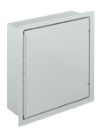
SECTION C (cont’d)
WA-FM Series
The “WA-FM” series is a Wiegmann enclosure that is rated Nema Type 12 and 13 where the door is secured to the tub utilizing a continuous hinge and screws. These enclosures come with an external frame to allow the enclosure to be recessed in a wall (flush mount).
Applications
Designed for use as housings for electrical controls, terminals and instruments.
Specifications
Offered in sizes from 16”x12”x6” up to 36”x30”x8”.
Manufactured from carbon steel that is coated with ANSI 61 powder coat paint.
Gasket applied to the door.
Mounting holes are provided in the external frame.
Collar studs are provided for mounting optional sub panels.
Back Panel
“NP” style back panel

Slide 15
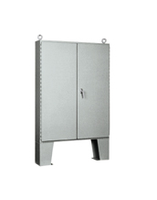
SECTION C (cont’d)
N12 Floor Mount Series
The “N12” floor mount series is a Wiegmann enclosure that is rated Nema Type 12 where the overlapping doors are secured to the tub utilizing continuous hinges and a 3 point key & pad lockable handle.
Applications
Designed for a wide array of usages to include housings for electrical controls, instruments, motor starters, drives and PLC’s.
Specifications
Offered in enclosure sizes from 54”x42”x8” up to 72”x72”x24”.
Manufactured from carbon steel that is coated with ANSI 61 powder coat paint.
Gasket applied to the doors and the over lapping door pocket.
With 12” tall floor mount kits welded to the bottom of the enclosure.
Collar studs are provided for mounting optional sub panels.
Sub panel supports and internal light mounting bracket are provided.
Lifting eyes are provided.
Back Panel
“NPDD” style back panel

Slide 16
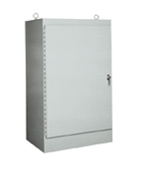
SECTION C (cont’d)
WA-FS, WA-FSD, WA-FSDA, & WA-FSDAD Series
The “WA-FS” free standing series is a Wiegmann enclosure that is rated Nema Type 12 where the door is secured to the tub utilizing a continuous hinge and a 3 point key & pad lockable handle.
WA-FS is single door single access
WA-FSD is double door single access
WA-FSDA is single door dual access
WA-FSDAD is double door dual access
Applications
Designed for a wide array of usages to include protection for electrical controls, instruments, motor starters, drives and PLC’s.
Specifications
Offered in enclosure sizes from 60”x24”x18” up to 90”x72”x36”.
Manufactured from carbon steel that is coated with ANSI 61 powder coat paint.
Gasket applied to the door.
Side uni-struts are provided for mounting optional sub panels.
An internal light mounting bracket is provided.
Lifting eyes are provided.
Back Panel
“WA-F1/F2” style back panel

Slide 17
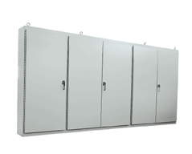
SECTION C (cont’d)
WA-M-E Series
The “WA-M-E” multi door free standing series is a Wiegmann enclosure that is rated Nema Type 12 that has 3, 4 or 5 doors on the front of the enclosure, where the doors are secured to the tub utilizing continuous hinges and 3 point key & pad lockable handles.
Applications
Designed for a wide array of usages to include housings for electrical controls, instruments, motor starters, drives and PLC’s.
Specifications
Offered in enclosure sizes from 86”x112”x14” up to 86”x187”x20”.
Manufactured from carbon steel that is coated with ANSI 61 powder coat paint.
Gasket applied to the doors and the over lapping door pockets.
Sub panels are provided and are mounted on collar studs.
Sub panel supports and an internal light mounting bracket is provided.
Lifting eyes are provided.
Back Panel
The back panels are included with the enclosure but “MD-P” style back panels can be ordered as replacements if needed.

Slide 18
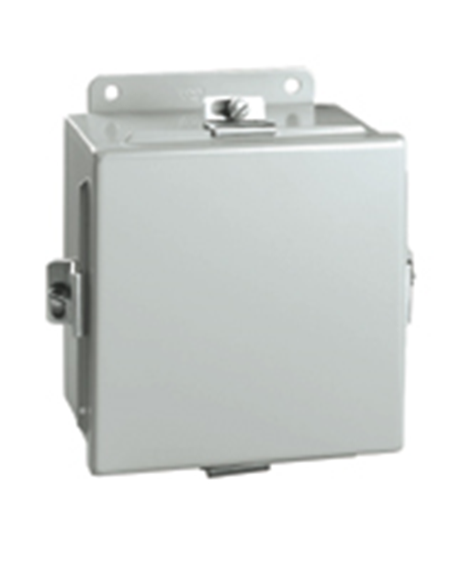
SECTION D – NEMA 4
BN4 Series (Lift-off cover wall mounts)
The “BN4” series is a Wiegmann enclosure that is rated Nema Type 4, 12 and 13 where the lid is secured to the tub utilizing screw clamps and does not have a hinged side.
Applications
Designed for use as junction boxes, terminal wiring boxes, electrical control enclosures and instrument housings.
Specifications
• Offered in sizes from 4”x4”x3” up to 16”x14”x6”.
• Manufactured from carbon steel that is coated with ANSI 61 powder coat paint.
• Gasket applied to the lid.
• External mounting plates are provided.
• Weld nuts are provided on sizes 6”x4”x3” and larger for mounting optional sub panels.
Back Panel
“P” series back panel

Slide 19
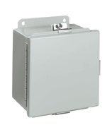
SECTION D (cont’d)
BN4-CH & B-CH Large Series (Hinge cover wall mounts)
The “BN4-CH” series is a Wiegmann enclosure that is rated Nema Type 4, 12 and 13 where the door is secured to the tub utilizing a continuous hinge and screw clamps.
Applications
Designed for use as junction boxes, terminal wiring boxes, electrical control enclosures and instrument housings.
Specifications
Offered in sizes from 4”x4”x3” up to 16”x14”x6”.
Manufactured from carbon steel that is coated with ANSI 61 powder coat paint.
Gasket applied to the door.
External mounting plates are provided.
Weld nuts are provided on sizes 6”x4”3” and larger for mounting optional sub panels.
Back Panel
“P” series back panel

Slide 20
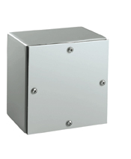
SECTION D (cont’d)
WA-GSC Series (Screw cover wall mounts)
The “WA-GSC” series is a Wiegmann enclosure that is rated Nema Type 4 and 3 where the lid is secured to the tub utilizing screws and there is no hinge side.
Applications
Designed for use as wiring boxes, junction boxes, pull boxes and terminal boxes.
Specifications
Offered in sizes from 6”x6”x4” up to 36”x36”x12”.
Manufactured from carbon steel that is coated with ANSI 61 powder coat paint or from galvanized steel (add “G” suffix to the end of the part number for galvanized).
Gasket applied to the lid.
No mounting means are provided.
Back Panel
N/A

Slide 21
SECTION D (cont’d)
N412-C Series (Wall mounts)
The “N412-C” series is a Wiegmann enclosure that is rated Nema Type 4, 12, 13 and IP-66 where the door is secured to the tub utilizing concealed removable hinges and ¼ turn latches, or key & pad lockable handles on the N412-3PTC. The N412’s styles have the most extensive accessory offering.
Applications
Designed to house electronic controls, instruments, components and associated wiring.
Specifications
N412-C style offered in sizes from 12”x12”x6” up to 60”x36”x12”.
N412-WC offered in sizes from 12”x12”x6” up to 30”x24”20”.
N412-3PTC offered is sizes from 12”x12”x6” up to 60”x36”x12”.
Manufactured from carbon steel that is coated with ANSI 61 powder coat paint. N412-C and N412-WC are also offered in RAL 7035 powder coat paint (add “LG” suffix to the end of the part number for RAL 7035).
Gasket applied to the door.
Internal mounting holes are provided. These holes can also be used to install optional mounting feet that are required to maintain UL/CSA mounting requirements.
Collar studs are provided for mounting optional sub panels.
N412-WC style supplied with viewing windows.
Back Panel
“NP-C” series back panel
N412161206C
N4121206WC
N4122416063PTC

Slide 22
SECTION D (cont’d)
N412-CST Series (Slop top wall mounts)
The “N412-CST” series is a Wiegmann enclosure that is rated Nema Type 4, 12, 13 and IP-66 where the door is secured to the tub utilizing concealed removable hinges and ¼ turn latches. The top of the enclosure and the upper door opening flange are sloped on these enclosures for accelerated run off of liquids.
Applications
Designed to house electronic controls, instruments, components and associated wiring. The slope top design is ideal for applications where wash down treatments are performed.
Specifications
Offered in sizes from 12”x12”x6” up to 60”x36”x12”.
Manufactured from carbon steel that is coated with ANSI 61 powder coat paint.
Gasket applied to the door.
Internal mounting holes are provided. These holes can also be used to install optional mounting feet that are required to maintain UL/CSA mounting requirements.
Collar studs are provided for mounting optional sub panels.
Back Panel
“NP-C” series back panel

Slide 23
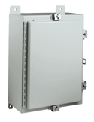
SECTION D (cont’d)
N4 Series (Wall mounts)
The “N4” series is a Wiegmann enclosure that is rated Nema Type 4, 12 and 13 where the door is secured to the tub utilizing a continuous hinge and screw clamps.
Applications
Designed to house electronic controls, instruments, components and associated wiring.
Specifications
Offered in sizes from 16”x12”x6” up to 60”x36”x16”.
Manufactured from carbon steel that is coated with ANSI 61 powder coat paint.
Gasket applied to the door.
External mounting feet are provided.
Collar studs are provided for mounting optional sub panels.
A hasp and staple are provided for padlocking.
Back Panel
“NP” series back panel

Slide 24
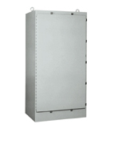
SECTION D (cont’d)
N4-FS Series (Free standings)
The “N4S-FS” series is a Wiegmann enclosure that is rated Nema Type 4, 12 and 3 where the door is secured to the tub utilizing a continuous hinge and screw clamps.
Applications
Designed to house electronic controls, instruments, components and associated wiring.
Specifications
Offered in enclosure sizes from 72”x25”x18” up to 72”x37”x24”.
Manufactured from carbon steel that is coated with ANSI 61 powder coat paint.
Gasket applied to the door.
Side uni-struts are provided for mounting optional sub panels.
Hasp and staple are provided for padlocking.
An internal light mounting bracket is provided.
Lifting eyes are provided.
Back Panel
N/A

Slide 25
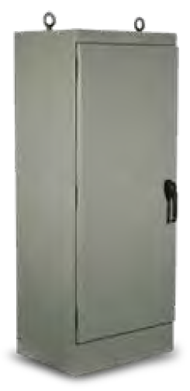
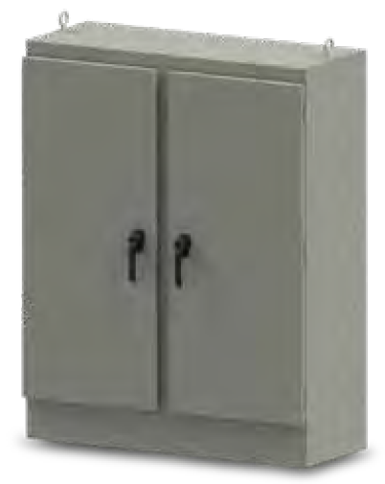
SECTION D (cont’d)
WRD-FS4 & WRD-FSD4 Series (Free standings)
The “WRD” series is a Wiegmann enclosure that is rated Nema Type 4, 12 and 3R where the door is secured to the tub utilizing a removable hinge and key & pad lockable handles.
Applications
Designed for a wide array of usages to include housings for electrical controls, instruments, motor starters, drives and PLC’s.
Specifications
Offered in enclosure sizes from 60”x24”x18” up to 90”x36”x36” (single door) and 60”x48x”36 up to 90”x36”x36” (double door) .
Manufactured from carbon steel that is coated with ANSI 61 powder coat paint.
Gasket applied to the door.
Side uni-struts are provided for mounting optional sub panels.
Lifting eyes are provided.
Back Panel
“WA-F1/2” series back panels

Slide 26
SECTION D (cont’d)
WA-FSN43PT Series (Free standings)
The “WA-FSN43PT” series is a Wiegmann enclosure that is rated Nema Type 4, 12 and 3 where the door is secured to the tub utilizing a continuous hinge and a key & pad lockable handle
Applications
Designed to house electronic controls, instruments, components and associated wiring.
Specifications
Offered in enclosure sizes from 60”x24”x18” up to 90”x36”x36”.
Manufactured from carbon steel that is coated with ANSI 61 powder coat paint.
Gasket applied to the door.
Side uni-struts are provided for mounting optional sub panels.
An internal light mounting bracket is provided.
Lifting eyes are provided.
Back Panel
“WA-F1/2” series back panels

Slide 27
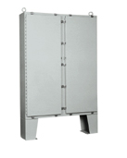
SECTION D (cont’d)
N4D Series (Floor mounts)
The “N4D” series is a Wiegmann enclosure that is rated Nema Type 4, 12 and 3 where the doors are secured to the tub utilizing continuous hinges and screw clamps.
Applications
Designed to house electronic controls, instruments, components and associated wiring.
Specifications
Offered in enclosure sizes from 62”x48”x10” up to 74”x72”x24”.
Manufactured from carbon steel that is coated with ANSI 61 powder coat paint.
Gasket applied to the doors.
With 12” tall floor mount kits welded to the bottom of the enclosure.
Collar studs are provided for mounting optional sub panels.
Hasp and staple are provided for padlocking.
Sub panel supports and internal light mounting bracket are provided.
Lifting eyes are provided.
Removable center post between doors permits easy sub panel installation.
Back Panel
“NPDD” series back panels

Slide 28
SECTION D (cont’d)
N4D-3PT Series (Floor mounts)
The “N4D-3PT” series is a Wiegmann enclosure that is rated Nema Type 4, 12 and 3 where the doors are secured to the tub utilizing continuous hinges and key & pad lockable handles.
Applications
Designed to house electronic controls, instruments, components and associated wiring.
Specifications
Offered in enclosure sizes from 62”x48”x10” up to 74”x72”x24”.
Manufactured from carbon steel that is coated with ANSI 61 powder coat paint.
Gasket applied to the doors.
With 12” tall floor mount kits welded to the bottom of the enclosure.
Collar studs are provided for mounting optional sub panels.
Sub panel supports and internal light mounting bracket are provided.
Lifting eyes are provided.
Removable center post between doors permits easy sub panel installation.
Back Panel
“NPDD” series back panels

Slide 29
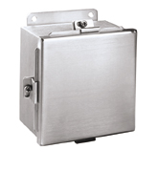
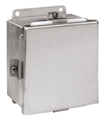
SECTION E – Stainless Steel / Aluminum
BN4-SS & BN4-AL Series (Wall mounts)
The “BN4-SS” and “BN4-AL” series are Wiegmann enclosures that are rated Nema Type 4X, 4, 12 and 13 where the lid is secured to the tub utilizing screw clamps and does not have a hinged side.
Applications
Designed for use as junction boxes, terminal wiring boxes and instrument housings.
Specifications
Offered in sizes from 4”x4”x3” (6”x6”x4” for AL) up to 16”x14”x6”.
Manufactured from 304 stainless steel, 316L stainless steel (add “A” suffix to end of part number for 316L stainless), or 5052-H32 aluminum
Gasket applied to the lid.
External mounting plates are provided.
Weld nuts are provided on sizes 6”x4”3” and larger for mounting optional sub panels.
Back Panel
“P” series back panels
BN4060604SS
BN4060604AL

Slide 30
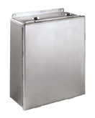
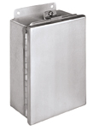
SECTION E (cont’d)
BN4-CHSS & BN4-CHAL Series (Wall mounts)
The “BN4-CHSS” and “BN4-CHAL” series are Wiegmann enclosures that are rated Nema Type 4X, 4, 12 and 13 where the door is secured to the tub utilizing a continuous hinge and screw clamps.
Applications
Designed for use as junction boxes, terminal wiring boxes and instrument housings.
Specifications
Offered in sizes from 6”x4”x4” up to 16”x14”x6”.
Manufactured from 304 stainless steel, 316L stainless steel (add “A” suffix to end of part number for 316L stainless), or 5052-H32 aluminum
Gasket applied to the lid.
External mounting plates are provided.
Weld nuts are provided for mounting optional sub panels.
Back Panel
“P” series back panels
BN4141206CHSS
BN4080603CHAL

Slide 31
SECTION E (cont’d)
N412-SSC Series (Wall mounts)
The “N412-SSC” series is a Wiegmann enclosure that is rated Nema Type 4X, 4, 12, 13 and IP-66 where the door is secured to the tub utilizing concealed removable hinges and ¼ turn latches, or key & pad lockable handles on the N412-SS3PTC. The N412’s styles have the most extensive accessory offering.
Applications
Designed to house electronic controls, instruments, components and associated wiring.
Specifications
N412-SSC style offered in sizes from 12”x12”x6” up to 60”x36”x12”.
N412-WSSC offered in sizes from 12”x12”x6” up to 30”x24”20”.
N412-SS3PTC offered is sizes from 12”x12”x6” up to 60”x36”x12”.
N412-CSST offered in sizes fro m16”x12”x8” up to 60”x36”x12”
Manufactured from 304 stainless steel. N412-SSC are also offered in 316L stainless steel (N412-SSAC).
Gasket applied to the door.
Internal mounting holes are provided. These holes can also be used to install optional mounting feet that are required to maintain UL/CSA mounting requirements.
Collar studs are provided for mounting optional sub panels.
N412-WSSC style supplied with viewing windows.
Back Panel
“NP-C” series back panels
N142201606SSC
N41220206WSSC
N412201606SS3PTC
N412201612CSST

Slide 32
SECTION E (cont’d)
SSN4-WF3PT Series (Wall mounts)
The “SSN4-WF3PT” series is a Wiegmann enclosure that is rated Nema Type 4X, 4 and 12 where the doors are secured to the tub utilizing continuous hinges and 3 point key and pad lockable handles.
Applications
Designed to house electronic controls, instruments, components and associated wiring.
Specifications
Offered in sizes from 24”x42”x8” up to 48”x48”x12”.
Manufactured from 304 stainless steel.
Gasket applied to the door.
External mounting holes are provided.
Collar studs are provided for mounting optional sub panels.
Removable center post between doors permits easy sub panel installation.
Back Panel
“NP” series back panels for sizes up to 36”x60”x12”
“NPDD” series back panels for sizes 42”x42”x12” and above

Slide 33
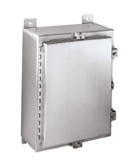
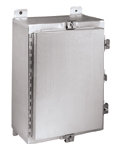
SECTION E (cont’d)
SSN4 & ALN4 Series (Wall mounts)
The “SSN4” and “ALN4” series are Wiegmann enclosures that are rated Nema Type 4X, 4, 12 and 13 where the door is secured to the tub utilizing a continuous hinge and screw clamps.
Applications
Designed to house electronic controls, instruments, components and associated wiring.
Specifications
Offered in sizes from 16”x12”x6” up to 60”x36”x16”.
Manufactured from 304 stainless steel, 316L stainless steel (add “A” suffix to end of part number for 316L stainless), OR 5052-H32 aluminum.
Gasket applied to the door.
External mounting feet are provided.
Collar studs are provided for mounting optional sub panels.
A hasp and staple are provided for padlocking.
Back Panel
“NP” series back panels
SSN4161206
ALN4161206

Slide 34
SECTION E (cont’d)
SSN4-3PT & SSN4-3PTW Series (Wall mounts)
The “SSN4-3PT” and “SSN4-3PTW” series are Wiegmann enclosures that are rated Nema Type 4X, 4, 12 and 13 where the door is secured to the tub utilizing a continuous hinge and screw clamps. The SSN4-3PTW has a white powder coat applied for applications where direct sunlight on raw stainless is an issue.
Applications
Designed to house electronic controls, instruments, components and associated wiring.
Specifications
SSN4-3PT offered in sizes from 24”x20”x6” up to 36”x36”x12”.
SSN4-3PTW offered in sizes from 24”x24”x8” up to 60”x36”x12”.
SSN4-3PT manufactured from 304 stainless steel or 316L stainless steel (add “A” suffix to end of part number for 316L stainless).
SSN4-3PTW manufacture from 304 stainless steel with white polyester powder coat paint
Gasket applied to the door.
External mounting feet are provided.
Collar studs are provided for mounting optional sub panels.
Back Panel
“NP” series back panels
SSN42420063PT
SSN43024083PTW

Slide 35
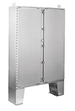
SECTION E (cont’d)
SSN4D & SSN4D-3PT Series (Floor mounts)
The “SSN4D” and “SSN4D-3PTW” series are Wiegmann enclosures that are rated Nema Type 4X, 4, 12 and 13 where the door is secured to the tub utilizing a continuous hinge and screw clamps (SSN4D) or 3-point key and pad lockable handles (SSN4D-3PT).
Applications
Designed to house electronic controls, instruments, components and associated wiring in a wide variety of applications to include, but not limited to, food processing, pharmaceutical manufacturing, petro-chemical plants, pulp and paper processing and wastewater treatment facilities.
Specifications
Offered in enclosure sizes from 62”x48”x12” up to 74”x72”x24”.
Manufactured from 304 stainless steel or 316L stainless steel (SSN4D-3PT only; add “A” suffix to end of part number for 316L stainless).
Gasket applied to the doors.
With 12” tall floor mount kits welded to the bottom of the enclosure.
Collar studs are provided for mounting optional sub panels.
Hasp and staple are provided for padlocking.
Sub panel supports and internal light mounting bracket are provided.
Lifting eyes are provided.
Removable center post between doors permits easy sub panel installation.
Back Panel
“NPDD” series back panels
SSN4D747224
SSN4D6248123PT

Slide 36
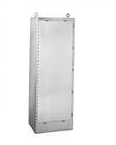
SECTION E (cont’d)
N4S-FSSS Series (Free standing)
The “N4S-FSSS” series is a Wiegmann enclosure that is rated Nema Type 4X, 4, 12 and 3 where the door is secured to the tub utilizing a continuous hinge and screw clamps.
Applications
Designed to house electronic controls, instruments, components and associated wiring in a wide variety of applications to include, but not limited to, food processing, pharmaceutical manufacturing, petro-chemical plants, pulp and paper processing and wastewater treatment facilities.
Specifications
Offered in enclosure sizes from 72”x25”x18” up to 72”x37”x24”.
Manufactured from 304 stainless steel or 316L stainless steel (add “A” suffix to end of part number for 316L stainless).
Gasket applied to the door.
Side uni-struts are provided for mounting optional sub panels.
Hasp and staple are provided for padlocking.
An internal light mounting bracket is provided.
Lifting eyes are provided.
Back Panel
“WA-F1/2” series back panels

Slide 37
SECTION E (cont’d)
WA-SSFSN43PT & WA-SSFSDN43PT Series (Free standing)
The “SSN4D” and “SSN4D-3PTW” series are Wiegmann enclosures that are rated Nema Type 4X, 4, 12 and 13 where the door is secured to the tub utilizing a continuous hinge and 3-point key and pad lockable handles.
Applications
Designed to house electronic controls, instruments, components and associated wiring in a wide variety of applications to include, but not limited to, food processing, pharmaceutical manufacturing, petro-chemical plants, pulp and paper processing and wastewater treatment facilities.
Specifications
WA-SSFSN43PT offered in enclosure sizes from 60”x24”x18” up to 90”x36”x36”.
WA-SSFSDN43PT offered in enclosure sizes from 60”x48”x18” up to 90”x72”x36”.
Manufactured from 304 stainless steel.
Gasket applied to the door(s).
Side uni-struts are provided for mounting optional sub panels.
An internal light mounting bracket is provided.
Lifting eyes are provided.
Removable center post between doors permits easy sub panel installation (WA-SSFSDN43PT only).
Back Panel
“WA-F1/2” series back panels
WA723618SSFSN43PT
WA726024SSFSDN43PT

Slide 38
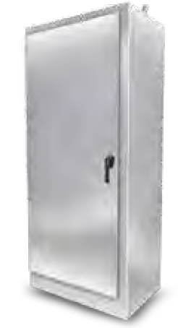
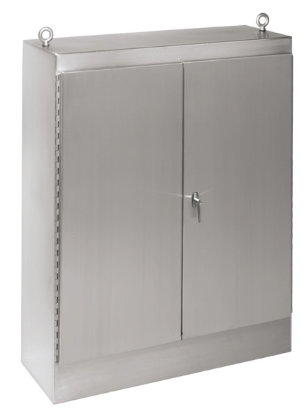
SECTION E (cont’d)
WA-FSSS & WA-FSDSS Series (Free standing)
The “WA-FSSS” (single door) and “WA-FSDSS” (double door) free standing series are Wiegmann enclosures that are rated Nema Type 12 where the doors are secured to the tub utilizing continuous hinges and 3 point key & pad lockable handles. Though only rated Type 12, these enclosures are fabricated from stainless steel.
Applications
Designed for a wide array of usages to include housings for electrical controls, instruments, motor starters, drives and PLC’s.
Specifications
WA-FSSS offered in enclosure sizes from 60”x24”x18” up to 90”x36”x36”.
WA-FSDSS offered in enclosure sizes from 60”x48”x18 up to 90”x72”x36”.
Manufactured from 304 stainless steel.
Gasket applied to the doors and the WA-FSDSS over lapping door pocket.
Side uni-struts are provided for mounting optional sub panels.
An internal light mounting bracket is provided.
Lifting eyes are provided.
Back Panel
“WA-F1/2” series back panels
WA602418FSSS
WA604818FSDSS

Slide 39
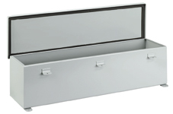
SECTION H – Wireways and Fittings
T-CH Series
The “T-CH” trough series are Wiegmann enclosures that are rated Nema Type 12 and 13 where the door is secured to the tub utilizing a continuous hinge and screw clamps.
+
Applications
Designed to protect electrical wiring where a Type 12 rating is suitable.
Specifications
Offered in sizes from 2.50”x2.50”x12” up to 12”x12”x60”.
Manufactured from carbon steel that is coated with ANSI 61 powder coat paint.
Gasket applied to the door.
External mounting feet are provided.
Back Panel
N/A

Slide 40

SECTION H – Wireways and Fittings
JW Series
The “JW” series are Wiegmann wireways and fittings that are rated Nema Type 12 where the door on the wireway is secured to the tub utilizing butt hinges and screw clamps. A wireway has open ends before they are either connected to another straight section of wireway or various fittings that mount onto the holes provided in the wireway ends. The JW series of wireway have full connecting rings seam welded onto the ends and are a feed through design of wireway. The various fittings are used to address the open ends on a run of a straight section of wireway. The JW series of fittings do not have doors.
Applications
Designed to protect electrical wiring where a Type 12 rating is suitable.
Specifications
Offered in sizes from 2.50”x2.50”x12” up to 8”x8”x120”.
Manufactured from carbon steel that is coated with ANSI 61 powder coat paint.
Gasket applied to the door.
Fittings types are Telescopes, Cut Offs, 90 Degree Elbows, 45 Degree Elbows, Tee Tops, Crosses, End Plates, Box Adapters, Reducers, Drop Hangers, Bracket Hangers, Nipples, Swivel Nipples, Flexible Fittings and Barrier Kits.
Back Panel
N/A

Slide 41

SECTION H – Wireways and Fittings
LJW Series
The “LJW” series are Wiegmann wireways and fittings that are rated Nema Type 12 where the door on the wireway is secured to the tub utilizing butt hinges and screw clamps. A wireway has open ends before they are either connected to another straight section of wireway or various fittings that mount onto the holes provided in the wireway ends. The LJW series of wireway have U shaped connecting rings seam welded onto the ends and are a lay in design of wireway. The various fittings are used to address the open ends on a run of a straight section of wireway. The LJW series of fittings have doors to allow for a lay in of wiring on an entire wireway run.
Applications
Designed to protect electrical wiring where a Type 12 rating is suitable.
Specifications
Offered in sizes from 2.50”x2.50”x12” up to 8”x8”x120”, 6”x12”x120” is also offered.
Manufactured from carbon steel that is coated with ANSI 61 powder coat paint.
Gasket applied to the door.
Fittings types are Telescopes, Cut Offs, 90 Degree Elbows (top, inside or outside), 45 Degree Elbows (top, inside or outside), Tees (top or outside), Crosses, End Plates, Box Adapters, Reducers, Drop Hangers, Bracket Hangers, Nipples, 12” Length Clockwise Transposition, 12” Length Counter Clockwise Transpositions, 90 Degree Clockwise Elbow, 90 Degrees Counter Clockwise Elbow, Quick Release Flat Sealing Plates, 90 Degree Angle Sealing Plates and Barrier Kits.
Back Panel
N/A

Slide 42
SECTION H (cont’d)
SSLJW Series (Free standing)
The “SSJW” series are Wiegmann wireways and fittings that are rated Nema Type 12 and 4X (fittings are only type 12) where the door on the wireway is secured to the tub utilizing butt hinges and screw clamps. A wireway has open ends before they are either connected to another straight section of wireway or various fittings that mount onto the holes provided in the wireway ends. The SSJW series of wireway have full connecting rings seam welded onto the ends and are a feed through design of wireway. The various fittings are used to address the open ends on a run of a straight section of wireway. The SSJW series of fittings do not have doors.
Applications
Designed to protect electrical wiring in corrosive environments.
Specifications
Offered in sizes from 4”x4”x12” up to 6”x6”x120”.
Manufactured from 304 stainless steel.
Gasket applied to the door.
Fittings types are Telescopes, 90 Degree Elbows, 45 Degree Elbows, Tee Tops, End Plates, Box Adapters, Reducers, Bracket Hangers, 6” Straight Nipples and Flexible Fittings.
Back Panel
N/A

Slide 43


